Slide 1
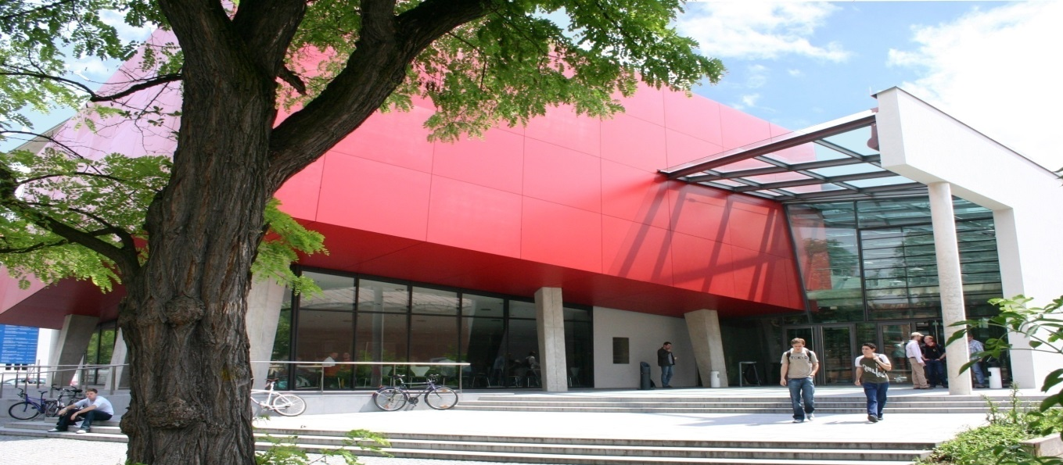
The Department of
Electrical Engineering and
Information Technology
at the University of Applied Sciences Munich
Lothstraße 64
80335 Munich, Germany
see also: http://www.ee.hm.edu/

Slide 2

Munich University of Applied Sciences − MUAS
Largest University of Applied Sciences in Bavaria
- 18300 students, 500 professors, 660 employees, 800 visiting lecturers
- 42 bachelor, 43 master - 5000 beginners
4 Main Areas of Education
- Engineering, science and technology 66,6%
- Economy and business administration 19,4%
- Social sciences 11,3%
- Design 2,7%
Organized in 14 Departments („Fakultäten“ FK)
- FK01: Department of architecture
- FK02: Department of civil engineering
- FK03: Department of mechanical, automotive and aeronautical engineering
- FK04: Department of electrical engineering and information technology
- ....
- FK14: Department of tourism management
Notes:
Technik = 11854 Studenten Insgesamt 17.805 Studenten Stand 16.11.2015 Anfänger
Wirtschaft = 3455 Studenten
Design = 476 Studenten
Sozial = 2020 Studenten

Slide 3
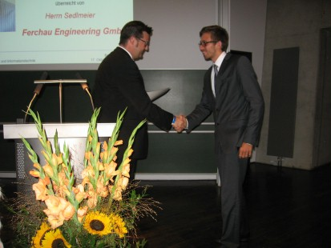


Department − Overview
Department Structure
- approx. 1300 students / 340 freshman/year
- 45 fulltime professors
- 30 other employees (lab and admin)
- 50 visiting lecturers (about 30 each semester)
- about 32 laboratory facilities for teaching
and research
Bachelor Programs
- Bachelor „Electrical Engineering and Information Technology“ (EI)
- Bachelor „Renewable Energy - Power Engineering“ (RE)
- Bachelor „Electrical Engineering - Electromobility“ (EM)
Master Programs
- Master „Electrical Engineering“ (ET)
- Master „Systems Engineering“ (SE)

Slide 4
Structure of Bachelor- and Masterprograms
Master Electrical Engineering
Master Systems Engineering
Master of Science
Master of Systems Eng.
10
Masterthesis
10
Masterthesis
9
theoretical courses
9
theoretical courses
8
theoretical courses
8
theoretical courses
qualification test
qualification test
Bachelor
Bachelor
Bachelor
7
courses + bachelor thesis
.
Choice
between
AE, AT,
KT, TI
7
courses + bachelor thesis
.
7
courses + bachelor thesis
.
OUTSIDE
HM
6
courses (main studies)
6
courses (main studies)
6
courses (main studies)
5
industrial training period
5
industrial training period
5
industrial training period
preliminary test
preliminary test
preliminary test
4
courses (basic studies)
4
courses (basic studies)
4
courses (basic studies)
3
courses (basic studies)
3
courses (basic studies)
3
courses (basic studies)
intermediate test
intermediate test
1. Hürde
2
2
intermediate test
2
courses (basic studies)
courses (basic studies)
courses (basic studies)
1
courses (basic studies)
1
courses (basic studies)
1
courses (basic studies)
Bachelor EI
Bachelor RE
Bachelor EM
29.03.2018
4
Notes:
-280 listed industrial partners which are valided to take studends for a industrial training period, there is a standardized contract which is signed by the industrial partner, student and us.
-TI computer engineering
-AT automation
-KT information aka communication technology
-AE general studies electical engineering

Slide 5









HM Dual Study program
We offer so called dual studies opportunities in cooperation with the consortium university dual bavaria and with numerous industrial partner companies.
There are two basic types:
studies and vocational training in combination
  Duration 4,5 years
  Dual degree: Bachelor degree and certificate from Chamber of Commerce and Industry
studies with intensive industrial internship periods
  Bachelor: duration 3,5 years
  Master: duration 1,5 years
  Student is during his studies funded by and bounded by contract to industrial partner
  Bachelor – Master degree
29.03.2018
5
Notes:
-template of dual study contract between student and industrial partner and a contract between partner and us.

Slide 6
Statistic Beginners
Notes:
-Undergoing changes over midddle time periods which makes it difficult to handle
-in germany public university, there is by law a claim on a seat if you like to study for the first time, but we have limited capacity so we fill the seats with the best graded students until our capacity is reached.
-there is a shift in interest inbetween the bachelor programs mainly due to public focus fed by long term industrial news

Slide 7
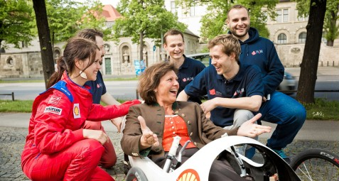
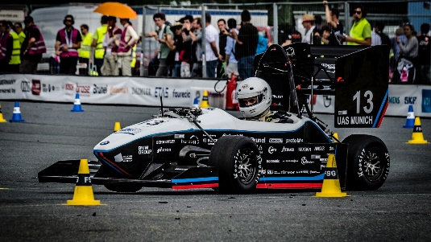
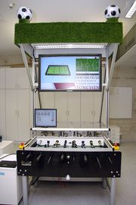
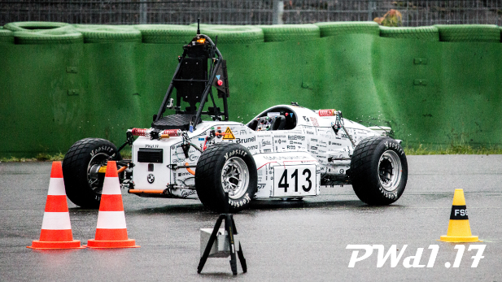
Long-term student projects
Shell Eco Marathon →
← Formula Student Electric
https://www.munichmotorsport.de
← Formula Student driverless
ProCK →
29.03.2018
7

Slide 8
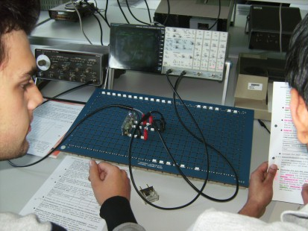
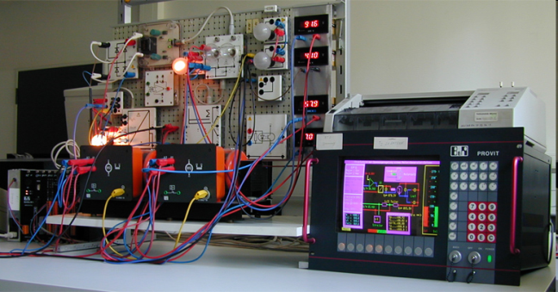
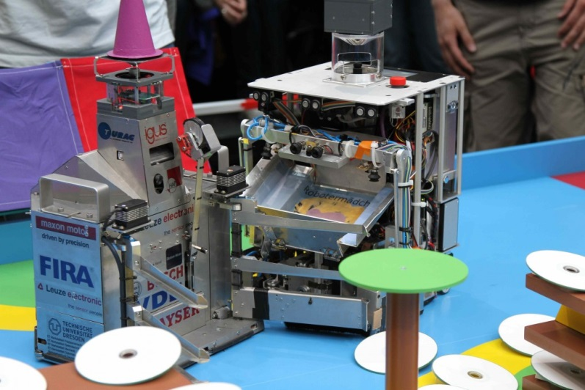
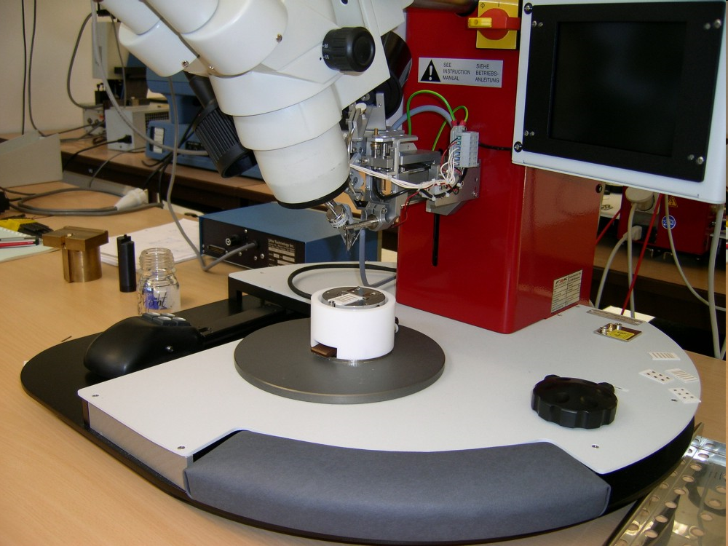
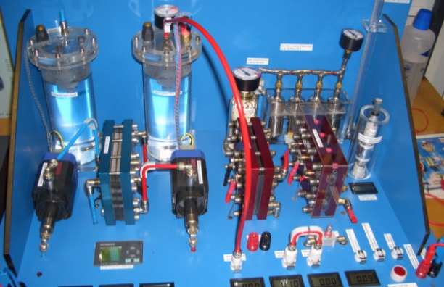

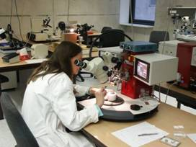
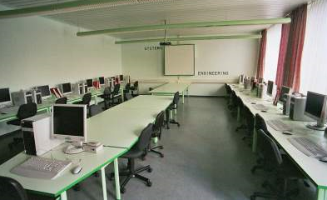

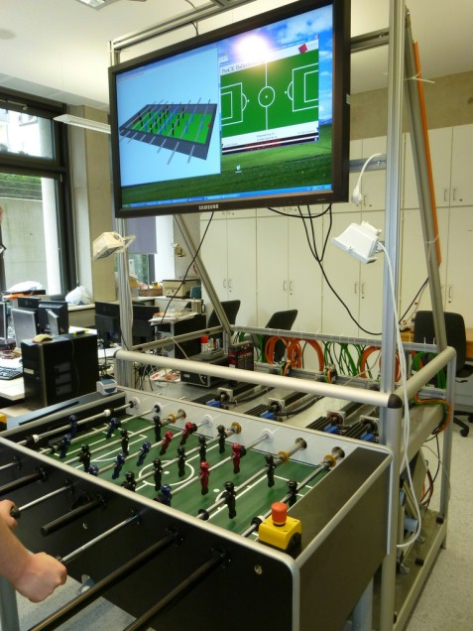
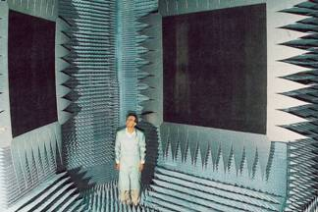
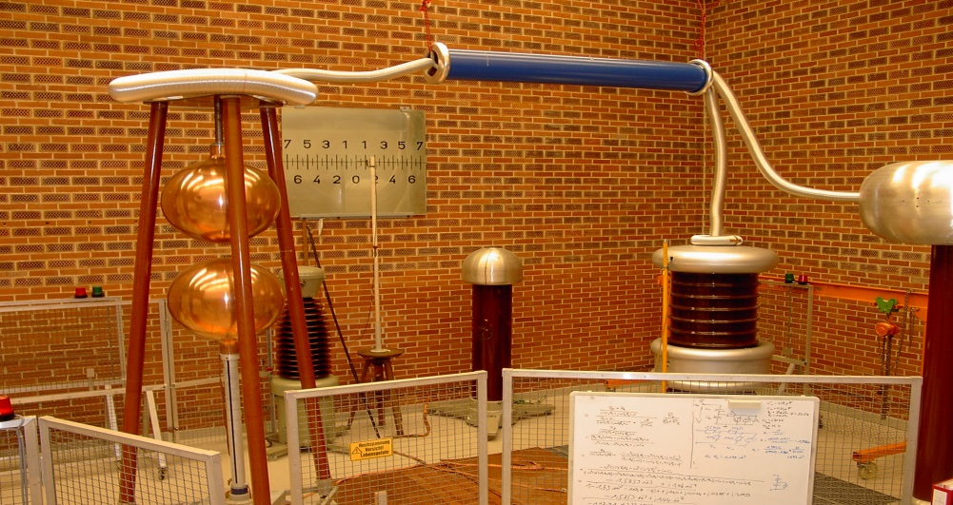
Research and Development
Notes:
Ca. 25 Forschungsschwerpunkte (inkl. An-Institute, Competence Center und Forschungsgruppen sowie einzelne ForscherInnen)

Slide 9
List of Laboratories (for Teaching and/or Research)
Packaging of Integrated Circuits
Realtime Operation Systems and Programming
Computer Networking
Digital Technologies
Electrical Engines and Machinery
Electrical Measurement Technology
Electronics
Fundamentals of Electric Engineering
High-Frequency Techniques
High Voltage Engineering
Power Electronics
Mechatronics
Microcomputer
Microcomputer Systems
Microelectronics
Microwave Techniques
Multimedia Applications
Pattern Recognition & Artificial Intelligence
Communication Satellites (Compact Range)
Optical Communications
Computer Applications
Control Theory and Technology
Analog Circuit Technology
Analog Signal Processing
Software Development
Solar Techniques und Energy Systems
Systems Engineering
Material Science
Communication Transmission
Computer-Kicker
Robotics Laboratory
Workshop fine mechanics

Slide 10
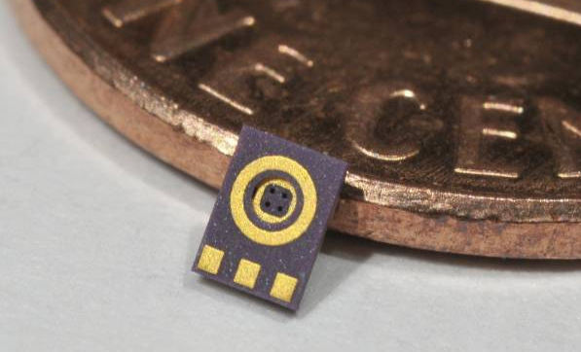
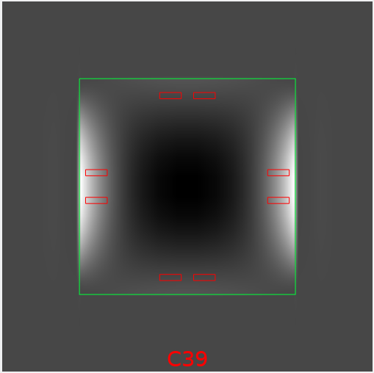
Applied Research: Sensors
Project SimuSens: Development of a framework for the simulation of the thermomechanical stress in sensors.
Project Partner: EPCOS, a TDK company
Funded by the German Ministry of Research
Tasks of the UAS:
  Development of material models for solder and polymers
  Simulation of pressure sensors and microphones
  Verification of the simulations by measurements
  Development of low stress packages
MEMS-Microphone 2 x 3 mm²
Stress on a pressure sensor chip
Prof. Dr. G. Feiertag
Notes:
Funded within the program „Forschung an Fachhochschulen mit Unternehmen“. Funding ca. 485,000 Euro for two PhD Students. Simulations with open source software Code_Aster. Project partners EPCOS and FK06

Slide 11
Applied Research: High frequency components
Project MoMiFI: Miniaturization of high frequency modules for mobile phones.
Project partners: RF360, a Qualcomm/TDK Joint Venture, ASM, Christian Koenen GmbH
Funded by the Bavarian Ministry of Economics
HF-Module, ca. 3 x 4 mm²
Tasks of the UAS-Munich:
  Development of copper pillar bumps as an replacement for solder bumps for micro-acoustic components
  Assembly of test modules, reliability testing, analysis and optimization of process and design
Copper Pillar Bumps
HF Filter
Module Substrate
Prof. Dr. G. Feiertag
Notes:
Funding within funding program electronic systems in Bavaria. Total funding ca. 900,000 € for ca. 1,900,000 € total project costs. The UAS gets ca. 350,000 Euro mainly for PhD student

Slide 12

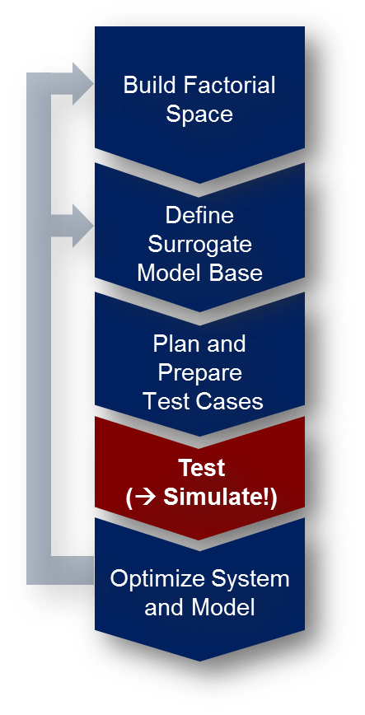
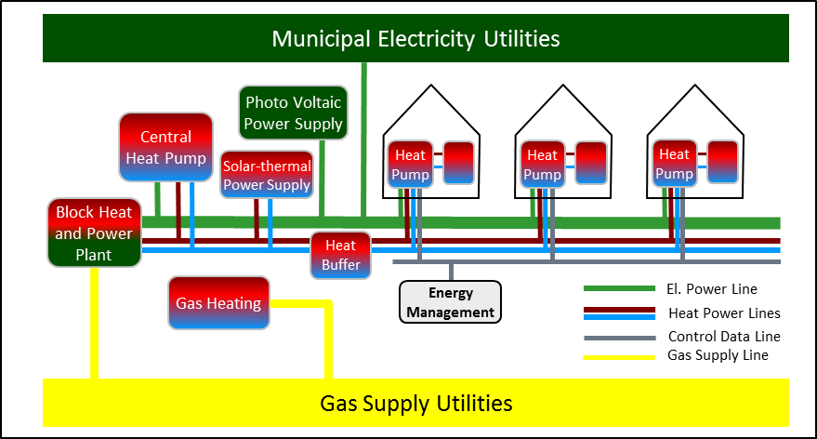
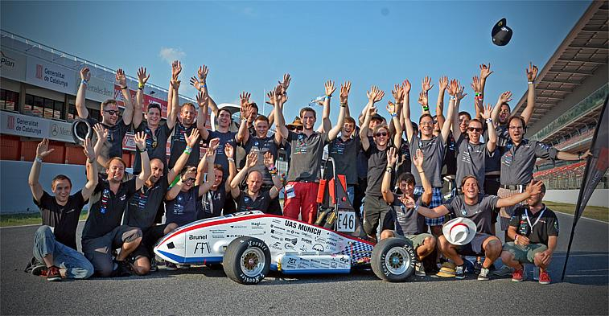
Applied Research: Engineering of Complex Systems
Entering new technologies involves:
  Large amount of unknown solutions
  Lack of „proof-of-concept“
Extending the V-Model allows to manage related uncertainties
„Hyper Space Exploration“ is a multi-criterial trade-off-analysis making use of:
  Design of (virtual) experiment
  Surrogate modelling
  Model-driven system optimization
Our applications:
  Sustainable energy systems
  Automotive top-level design (FEVs)
  Complex Controler Design
Prof. Dr. H. Palm
Notes:
Systems Engineering Labor
Wir beschäftigen uns mit der Entwicklung von komplexen Systemen im Umfeld disruptiver (nicht-kontinuierlicher) Technologiewechel
In diesem Umfeld tauchen beim Systementwurf typisch 2 Fragen auf: a) wie finde ich die für einen Anwendungsfall beste (anstelle der erstbesten) Lösung? b) Woher weiß ich ob diese Lösung funktioniert?
Da das Behebung von Fehlern beim Systembau ungefährt 10.000-mal soviel kostet wie diese Fehler bereits im Systementwurf zu eliminieren lohnt sich bei neuen Technologien die „Hyper-Space-Exploration (HSE)
Bei der HSE erweitern wir das V-Modell um einige Elemente: a) Design-of-(virtual)-Experiment basierte Studie b) Statistische Verfahren der Surrogat-Modell-Bildung c) Künstliche Intelligenz und Modell-basierte Optimierung
Unsere Anwendungen liegen in den Bereichen: a) Entwicklung nachhaltiger Energiesysteme b) Elektrofahrzeuge c) Entwurf komplexer Regler
Kontakt: Herbert.palm@hm.edu

Slide 13
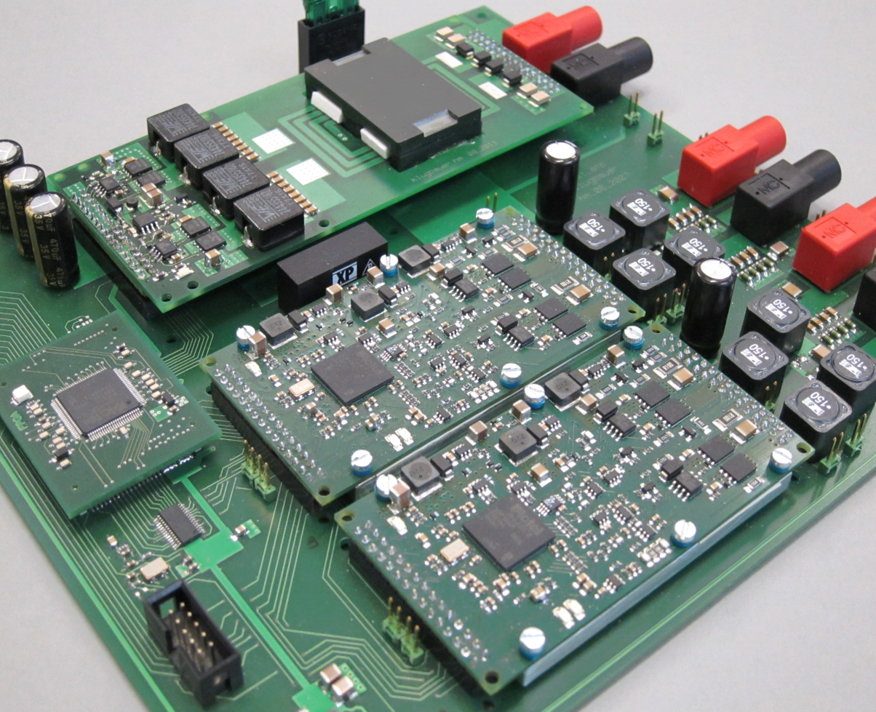
Applied Research: Energy Efficient Class-D Amplifiers for ELA
Topic: Energy-efficient 100V system amplifier for ELectroacoustic infrAstructure (ELA)
100V system amplifier for ELA without line transformer
Up to 400 W with 97% efficiency
without fan or heat sink
Module size only 9 cm x 5 cm x 1 cm
High efficiency under all load conditions due to integrated variable supply voltage concept (patented)
Switched-mode power supply using low-cost planar transformer
Continuous self-test of the whole system
Josef Klugbauer, Prof. Dr. C. Münker
29.03.2018
13
Notes:
Topic: Robust, extremely efficient Class-D amplifiers for deployment in public infrastructure systems
Public address audio systems in subway stations, shopping malls etc. usually are realized as 100 V systems, requiring bulky and expensive line transformers in the amplifier.The vast majority of amplifiers is existing systems rely on analog amplifiers with inherent low power efficiency.
The digital class-D amplifier developed in the Circuit Design Lab (Labor Schaltungstechnik) runs on an integrated variable supply voltage that minimizes losses under light to heavy load conditions. It reaches an efficiency of 97%, enabling operation of up to 400 W per module without fan or heat sink.
The supply voltage reaches up to 150 V, allowing operation in 100 V systems without the line transformer. The variable switched-mode power supply is implemented using a low-cost planar transformer with printed coils and a snap-on magnetic core.
The tiny module size of only 9 cm x 5 cm x 1 cm, the fan-less cooling and the lack of the line transformer allow implementing 16 amplifier channels in the space of one former analog amplifier with improved emergency battery operation.
Current research topics include further improvement of audio quality beyond HiFI DIN 45500 and asynchronous sample rate conversion for high-end operation in streaming media systems.

Slide 14
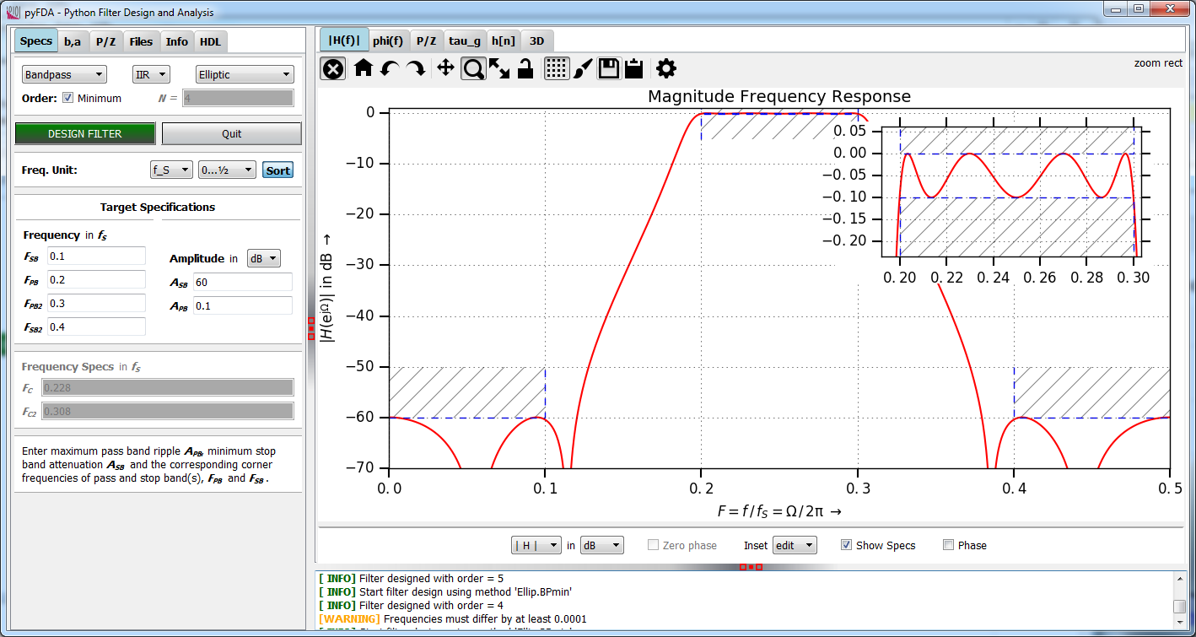
Applied Research: Digital Filter Design Tool pyFDA
Topic: User-friendly open-source tool for design, analysis and synthesis (VHDL and Verilog) of discrete-time fixpoint filters
Application Areas: Digital signal
processing and FPGA design
for R&D and education
Open-Source: Developed with
Python and Qt-Widgets
(github.com/chipmuenk/pyfda)
Modular architecture for fast
development of new filters
and analysis modules
Google Summer of Code 2018:
- Link pyFDA and myHDL (www.myhdl.org) for easy VHDL and Verilog code generation
- Implement more complex (a.o. systolic FIR) filters and synthesize them
Prof. Dr. C. Münker
29.03.2018
14
Notes:
14
Topic: Implementing fixpoint filters on FPGAs and low-cost (i.e. without floating point unit) microcontrollers is still a field where a lot of expert knowledge is required. The pyFDA tool eases the design and analysis process of those filters with a user-friendly UI and lots of analysis options. A fast fixpoint library allows quantization, re-simulation and export of fixpoint coefficients in various formats. The software is targeted for both educational and R&D purposes. New filter algorithms can be added easily (and have been added by users on GitHub) due to the modular architecture.
A Google Summer of Code Project has just started that targets the streamlining of the design process: The goal is to create a link between pyFDA and myHDL, a Python module for simulating and generating HDL code, allowing improved fixpoint filter simulations and direct export of VHDL and Verilog code.

Slide 15
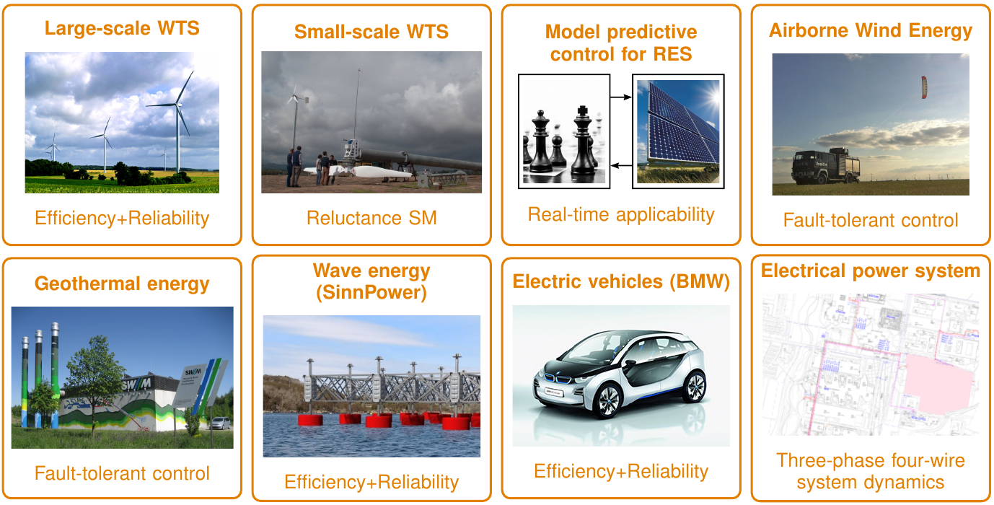
Applied Research: Fault-tolerant and efficient mechatronic and regenerative energy systems
Prof. Dr.-Ing. Christoph M. Hackl
27.03.18
15
Notes:
8 projects (see above)
9 PhD students,
Over 2 Mio. € budget (EU ITN H2020, DFG, Baverian government, BMBF, BMWi, etc.)
Over 100 peer-reviewed publications
Interdisciplinary approach: power electronics, electrical machines, mechatronic and regenerative energy systems & systems theory,
15
- 8 projects (see above)
-9 PhD students,
- Over 2 Mio. € budget (EU ITN H2020, DFG, Bavarian government, BMBF, BMWi, etc.)
- Over 100 peer-reviewed publications
- Interdisciplinary approach: power electronics, electrical machines, mechatronic and regenerative energy systems & systems theory

Slide 16

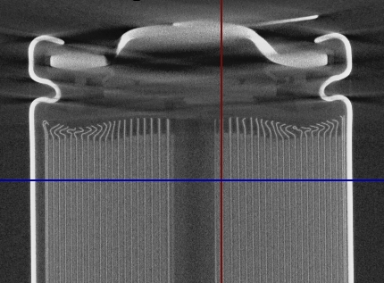
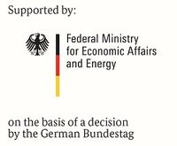







Applied Research: Detection & Localization of mechanically induced damages in lithium ion batteries (ReVISEDBatt)
Research:
Realistic mechanical stresses, such as shocks, vibrations and external forces
Damages in cell and module components
Effects on operational and aging behavior
Detection methods
Objectives:
Knowledge of damage mechanisms
Development of novel early detection methods
Online application in battery management systems
Project:
Project period:
2017/09 – 2020/09
Staff at HM:
one research fellow,
student workers
Notes:
Gesamtvorhaben umfasst umfangreiche Tests (Schock, Vibration, Druck) mit Batteriezellen und Modulen.
Schwerpunkt der HM: Detektion, Fehlererkennung → mögliche spätere Anwendung in einem Batteriemanagementsystem
Eine wiss. Mitarbeiter an der HM im Projekt (Bolormaa Große)
Foto Batterie mit dem CT vom Gregor Feiertag erstellt.

Slide 17
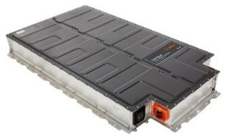
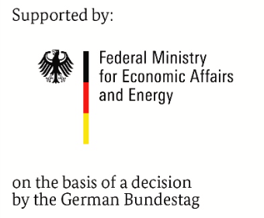



Applied Research: Universal connection of automotive traction batteries for stationary applications (UnABESA)
Second-Life applications
for traction batteries
Plug & Play
coupling element
AC-Grid
Research objectives
Universal architecture for different batteries and applications
Highly efficient power electronics with innovative control
Optimized power flow in heterogeneous battery systems
Applications
Frequency regulation
Peak shaving
Decentralized storage
Challenges
No standardized design
Different battery properties
Costs
Project:
Project period: 2017/06 – 2020/06
Staff at HM:
two research fellows,
student workers
Notes:
Automotive batteries provide high safety and reliability at quickly decreasing costs. Using these batteries in stationary applications, as first use or in 2nd-life, is thus desirable. Connecting these batteries to the electric AC-grid not only requires a power inverter, but also bulky transformers to match the different voltage levels and provide galvanic insulation. Often modifications to the control system (software and/or electronics) are necessary to operate these batteries outside a vehicle. In the project UnABESA an architecture is investigated and optimized that can overcome these disadvantages.
Core component of the project is the coupling element comprising a highly efficient DC/DC-converter with galvanic coupling and an intelligent interface that screens the automotive-specific communication interface. Hardware design of the power electronics, control and switching patterns as well as an optimized inductive component are research topics that aim at a highly efficient and compact converter. Furthermore, the development of a control strategy for the power sharing between different automotive-batteries is also part of the research.

Slide 18


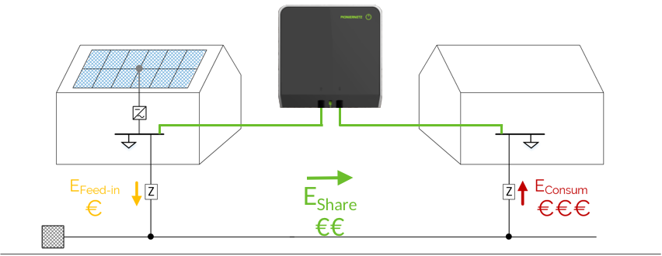
Applied Research: Private Grid Coupling
Hard Facts
Mains parallel
Galvanic isolated
Surplus energy transferred
Depending on energy production and - consumption
Customer Value
PV plant is more profitable
economic benefits for producer and receiver
more people get access to renewable energy.
contribution to a successful energy revolution
Prof. Dr. S. Schramm
Notes:
Private Grid Coupling – Goal: share renewable energy with neighbor
Government funded startup
3 founders from our department

Slide 19
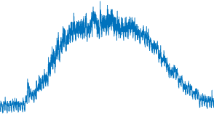
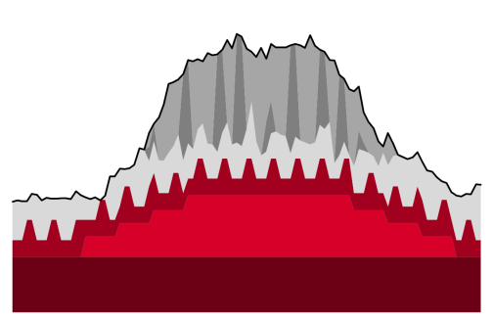

Applied Research: Analysis of complex energy systems
Goal: Development of a process for automated and data-based analysis of complex energy systems and identification of (essential) consumers
Research Interests:
- Which parameters influence energy consumption in complex energy systems?
- How can this data be captured and utilized?
- In which resolution and measuring accuracy are these data needed?
- Which methods of data analysis (big data, machine learning, NILM) can be applied to the data?
- How can consumers (types) be recognized?
- How can changing structures be recognized during operation?
Prof. Dr. S. Schramm
Notes:
Kurze Erklärung…

Slide 20





Applied Research: Industrial Projects
Renewable Energy Grid Integration, e.g. Development of a Modular Voltage Regulator, Grid Interaction of Renewable Generation, Declaration of Conformity
Energy Transition – “Energiewende”, e.g. Smart Distributed Reactive Power Compensation, Systematic Design of Sustainable Energy Cells
Renewable Energy for Developing Countries, e.g. PV-Hybrid System Design and Analysis, Sky Imager for Irradiation Forecast

Slide 21
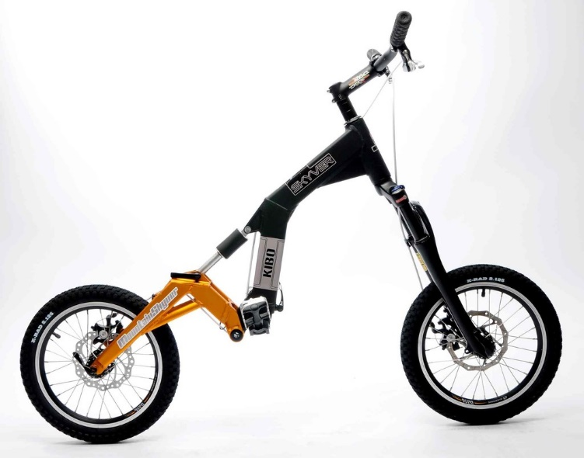
Applied Research: E-Scooter
Partner: UAS-Munich, Auswall
Tasks of UAS Munich
  development of electronics for motor control
  development of innovative motor control algorithms
    using new non-contact torque sensoring (magnetostriction)
    using heart-rate sensors to determine required motor torque (rehabilitation)
    development of “Pedelec-Mode“ for E-Scooter to avoid requirement for numberplates and to wear helmets for vehicles with motor support above 6km/h
Prof. Dr. S. Hecker
29.03.2018
21

Slide 22
Applied Research: ASG and ANC using existing Electric Drives
Partner: UAS-Munich (FK03+04), BMW, MdynamiX AG
also supported by BMWi (ZIM)
Idea: Using existing electric drives (e.g. steering motor) in
passenger cars as loudspeaker for
Active Sound Generation (ASG) for electric cars
  outside warning sounds for pedestrians (without additional outside loudspeaker)
  company typical branding of motor sound
Active Noise Cancellation (ANC) for combustion and electric cars
  suppressing tonal noise (e.g. cavity noise from tires or combustion motor noise)
  inside the car without using microphones and loudspeakers
  avoid expensive active and passive damper systems (e.g. active engine mounts)
Prof. Dr. S. Hecker
22

Slide 23
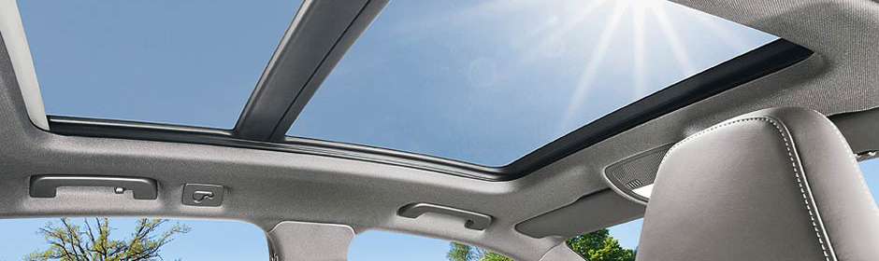

Applied Research: Anti-Pinch Protection for Sliding Roofs
Partner: UAS-Munich, Webasto AG
Tasks of UAS Munich
  Development of adaptive algorithms for correction of Hall sensor errors
  Development of a multi-rate observer for exact motor speed estimation
  Development of observer based fault detection algorithms for anti-pinch system
  Development of robust motor speed controller for improved roof acoustics
Prof. Dr. S. Hecker
29.03.2018
23
Notes:
Since 2012 we have a collaboration with Webasto to develop and improve the algorithms for speed control and the anti-pinch system for sliding roofs of vehicles.

Slide 24
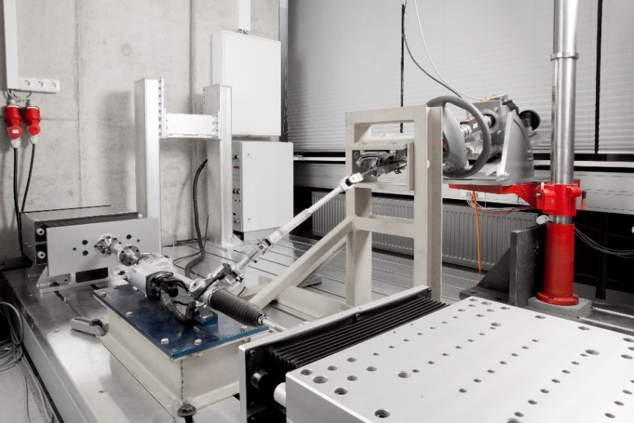
Applied Research: Multi purpose HiL-Testbench
Partner: UAS-Munich (FK 03+04), MdynamiX AG,
TU Vienna
Idea: development of high performance hardware
in the loop testbench for automotive components
Tasks
  Development of robust, model predictive, multi-input, multi-output control algorithms
  Allow HiL-tests for automotive components (e.g. steering system, engine mounts, active dampers) with bandwidths up to 40 Hz
  Real-time simulation of remaining vehicle dynamics and environment to allow driver in the loop testing
Prof. Dr. S. Hecker
29.03.2018
24

Slide 25
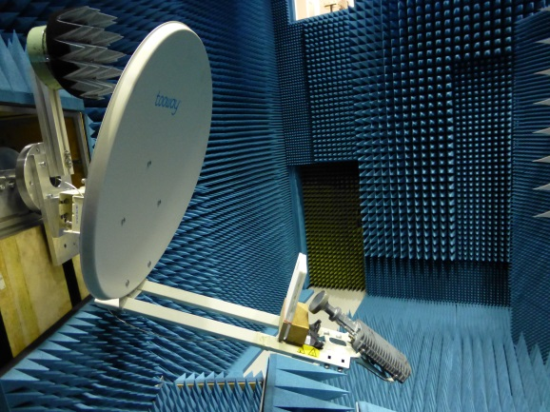
Frequency Selective Plate [FSP] for Multiplex Use of a Parabolic Antenna for TV und Internet
Direct order from Eutelsat S. A. (Paris)
worldwide third biggest provider of satellite communication services .
HM has the leadership in conception, development and qualification
Rollout of FSP actual in Greece, total volume 1 Million terminals (Europe, North Africa and Mead east)
Patent: Inventor is HM
Owner is Eutelsat
Follow up project starts in 2015,
runtime 3 years
one PHD Student, several student assistants
Direct competition with European enterprises and universities
Prof. Dr. G. Strauß
29.03.2018
Notes:
There is a growing market for internet access by satellite, especially for regions where the telecommunication infrastructure is weak. This is true not only for rural regions but also for strongly growing mega cities e.g. Istanbul or Paris. The French satellite provider Eutelsat offers a system with data rates of up to12 Mbit / s per user. The only prerequisites for this link to the internet are
a 30 Voltage source
the tooway terminal with a parabolic antenna and the tooway feed with modem
and of cause a direct view to the satellite
The system can handle more than one million terminals in Europe, North Africa and Middle East.
The HM has developed a so called Frequency Selective Plate (FSP), which allows the simultaneous and independent use of the antenna for TV and the described internet access. Instead of two parabolic antennas there is now only one antenna necessary. Because the product was developed for the mass market, there were tough constraints for the cost structure. Nevertheless the specifications for the Data Uplink has to be satisfied, otherwise other satellites in a geostationary orbit could be disrupted.
The FSP is now in use in Greece, and is about to be rolled out in Turkey. Triggered by the fast and successful development at the HM, a three year project will be started a.s.a.p. Especially software for calculating the electromagnetic fields has to be developed further, a PHD student will do more research and prepare the next round of development. The project is 100 percent funded by Eutelsat.

Slide 26
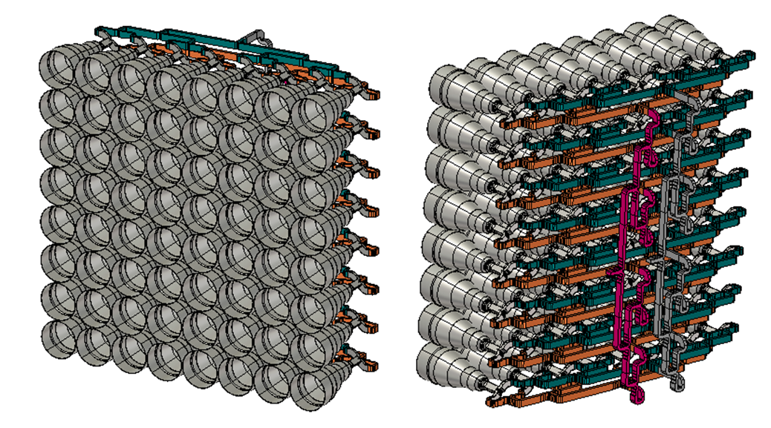
LISA MS+
Target: Development of an antenna system for very high data rates between low orbit satellites
Development for
„SatCom on the Move”
Space approval Mid 2015
CST Modell, NTP / Airbus S&D
Cooperation with
  Airbus (earlier EADS Astrium GmbH)
  Institute for Mobil and Satellite Communication IMST GmbH
  Technical University of Munich TUM,
  Institute for light weight construction
  Deutsches Zentrum für Luft- und Raumfahrt DLR
350 nm CMOS
Prof. Dr. G. Strauß
29.03.2018
Notes:
This project is funded by the BMBF. The goal is the development of an antenna system for a high data link between a satellite on a low orbit and a satellite on a geostationary orbit.
Partners are
Airbus (earlier EADS Astrium GmbH)
Institute for Mobil and Satellite Communication IMST GmbH
Institute for light weight construction, Technical University of Munich TUM
Deutsches Zentrum für Luft- und Raumfahrt DLR
The lab for Satcom will perform the measurements of the antenna, where very high precision is required. A space qualified system is expected to be up and running in summer 2015.

Slide 27
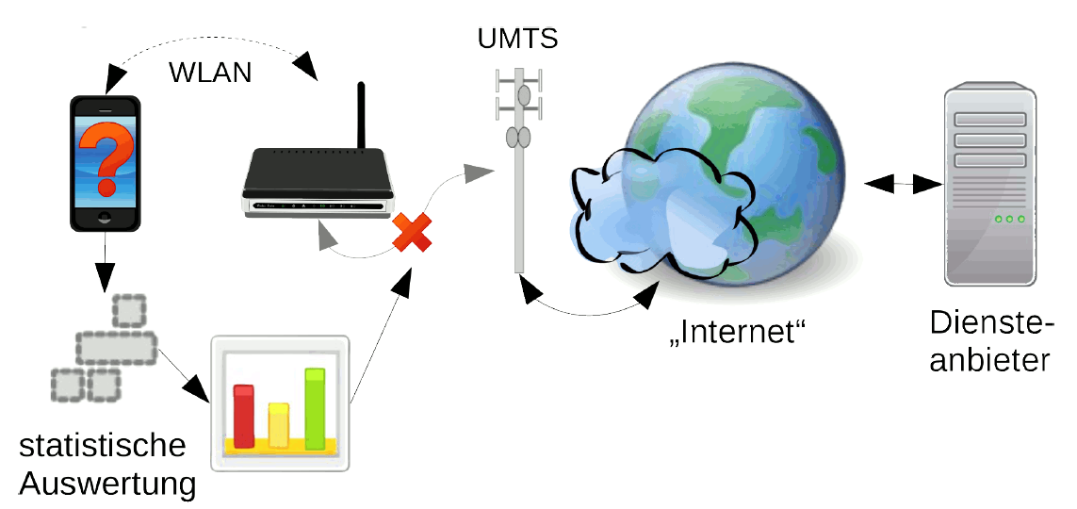
Applied Research: NetQoS
Issue: Classification of QoS-/QoE issues and assignment to sub networks in heterogeneous communication networks.
Cooperation with MINcom GmbH, Rohde & Schwarz Vertriebs GmbH,
Keynote SIGOS GmbH, Fraunhofer ESK
BMBF project – volume: 270 k€
Statistical models of the network parts using Hidden Markov Models
UMTS
WLAN
Internet
Provider
statistical
analysis
Prof. Dr. Th. Michael, Prof. Dr. M. Dippold, Prof. Dr. M. Paul
Notes:
The project NetQoS analyzes issues in Quality of Service (QoS) and Quality of Experience (QoE) of heterogeneous communication networks in user-accessible signal layers. These networks consist of different sub networks .e.g. a video stream comes over internet, a UMTS/LTE connection followed by a WLAN connection. Based on measurements, statistical models of the sub network and the complete network will be generated using Hidden Markov Models (HMM). With these models, a method will be developed to estimate in which network problems are originated and to classify the characteristics (e. g. the channel fading in the mobile section). This method will be implemented as heterogeneous QoS measurement system in a client-server solution.
In addition, a network emulator will be created using the statistical models. With it, a complete heterogeneous network can be simulated in the laboratory.
The project based on the predecessor project MobQoS is promoted by the BMBF and will be carried out in cooperation with industrial partners.

Slide 28
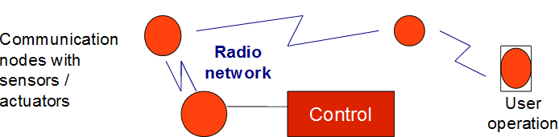
Applied Research: E min
Issue: Optimization of In-house Communication for Minimizing the Power Consumption in Buildings
Starting grant Hochschule München
  Sensor network for wireless communication
  Optimization of sensor network for minimum energy supply
  Operation strategies for minimum electrical power
  Operation strategies for minimum heating power
350 nm CMOS
Prof. Dr. T. Michael, Prof. Dr. M. Dippold

Slide 29
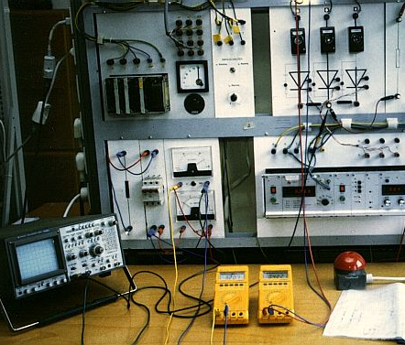
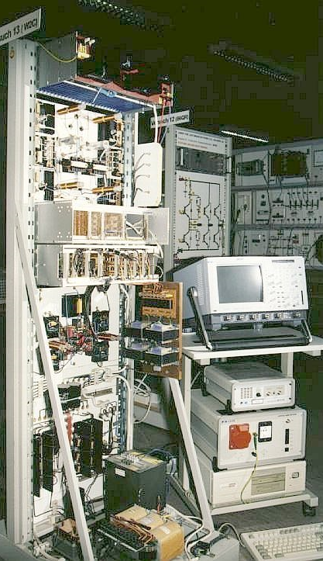
…some impressions of our labs
Power Electronics
Power Electronics

Slide 30
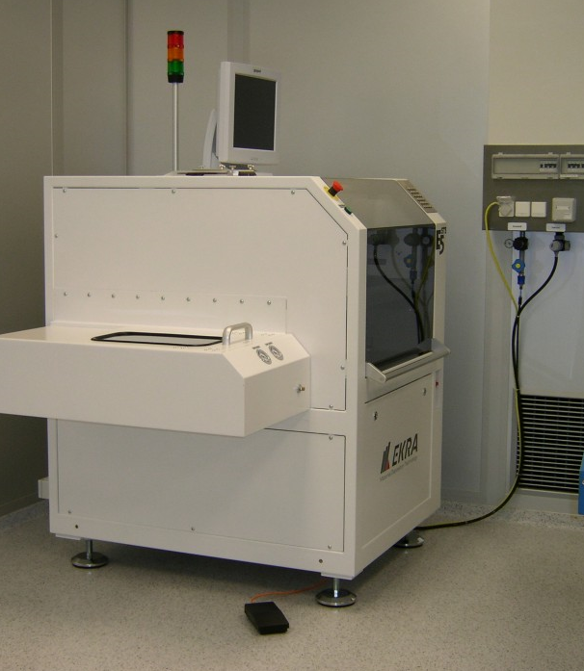
….more…
Microelectronics
Microelectronics

Slide 31
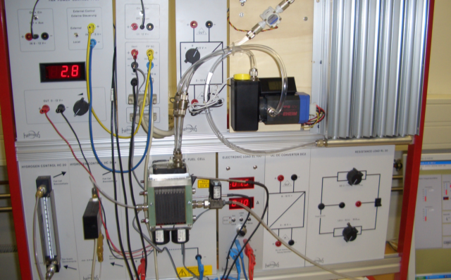

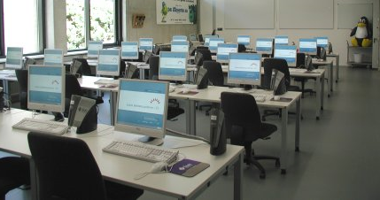
….and more …
Energy Systems
Energy Systems
High-Voltage
Engineering
Operating Systems
and Programming

Slide 32
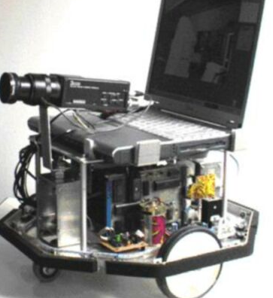
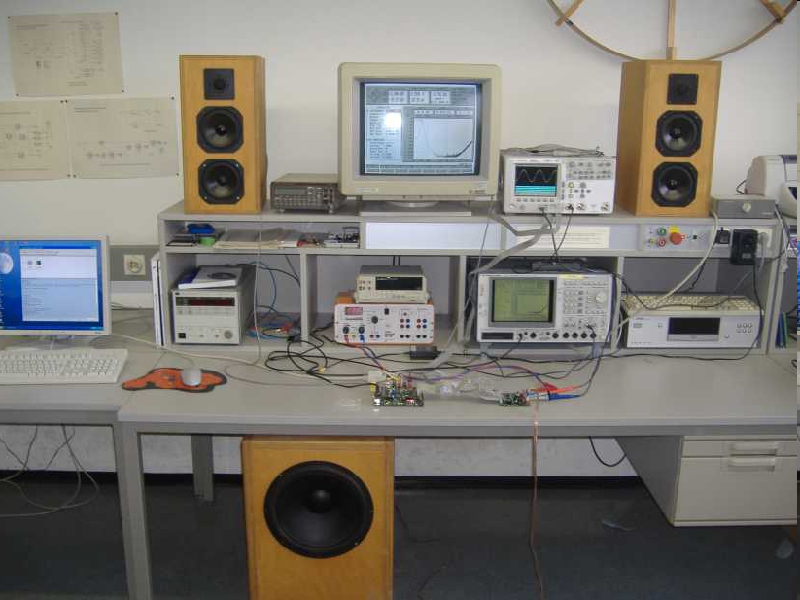
….and even more …
Pattern Recognition
& Artificial Intelligence
Systems Engineering
Digital Signal
Processing

Slide 33
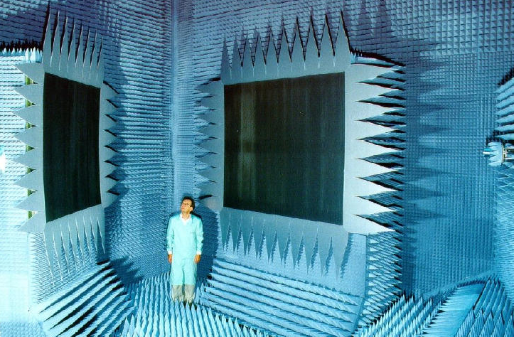
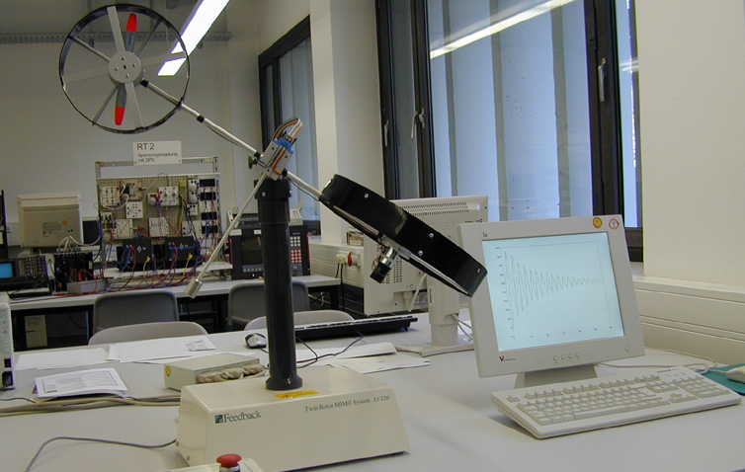
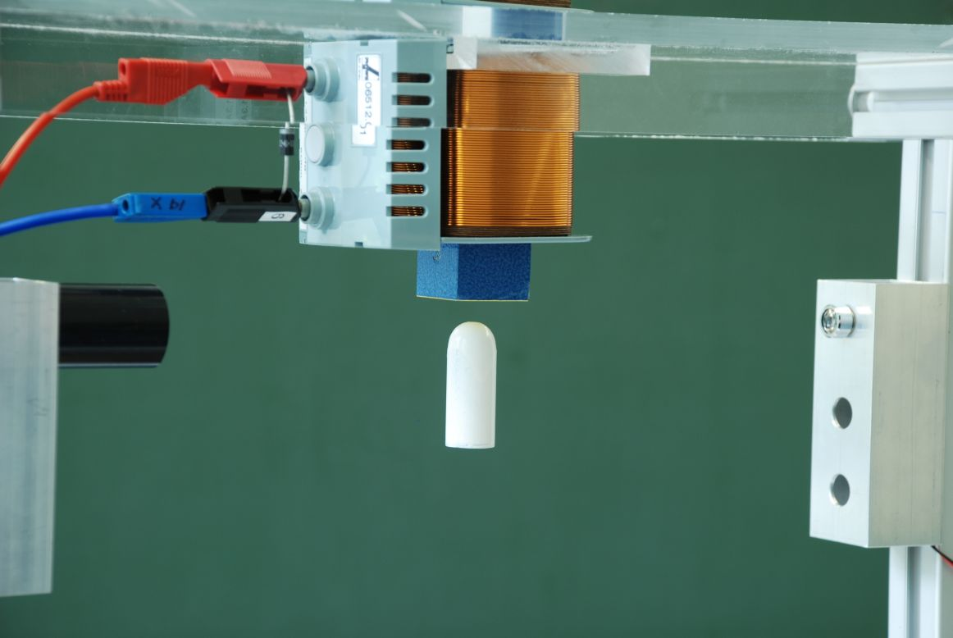
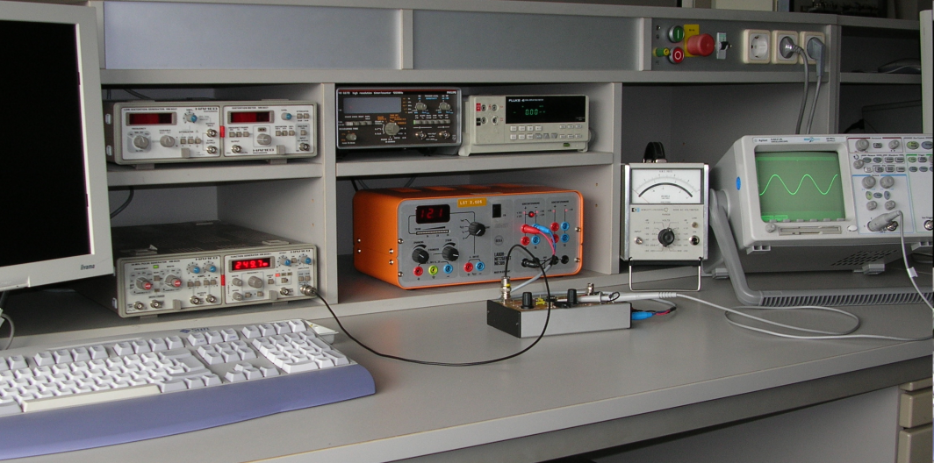
…the end
Comm. Satellites
Compact Range
Control Technology
Control Technology
Analog Circuit Technology

